Slide 1
Günthart & Co.KG
TRADITION
PASSION
INNOVATION

Slide 2
OLD TRADITIONS,
NEW ENTREPRENEURIAL SPIRIT
The company moved over to Hohentengen on the High Rhine, Germany
where Ernst Günthart came up with the groundbreaking idea of creating chocolate images on transfer foil.
Peter Günthart: Joining the family business
He plays a significant role in shaping the technology and takes on sales responsibilities.
1946
1963
Ernst Günthart founds the company
in a garage in Niederhasli, Switzerland
1956
New building for production and administration
1973
Ernst Günthart
transfer film
new building
Peter Günthart

Slide 3
PROFIT FROM
THIS VALUABLE EXPERIENCE.
The headquarters in Hohentengen on the High Rhine underwent expansion
featuring the construction of an extensive complex that includes impressive office spaces, warehouses and production facilities.
Expanding the product range
the company established its second core focus by adding gift item production alongside their existing production for decorations.
1978
1980
Stefan Günthart: Joining the family business
He contributes to the design and takes on responsibility for it.
1978
The first production facility in Asia is built
1981
Stefan Günthart
gift items
production facility
main location

Slide 4
WORLD FAME
AND POPULARITY.
Renovation work and new construction of the conference center
Renovation work is being carried out at the main location and a conference center is being built.
Patrick Günthart: Joining the family business
He takes over responsibilities in the office and in the management
1986
2022
Founding of the production facility in
Nong Khae (Thailand)
2016
New construction of the production facility in Złotoryja (Poland)
2023
production facility
Patrick Günthart
production facility
renovations

Slide 5
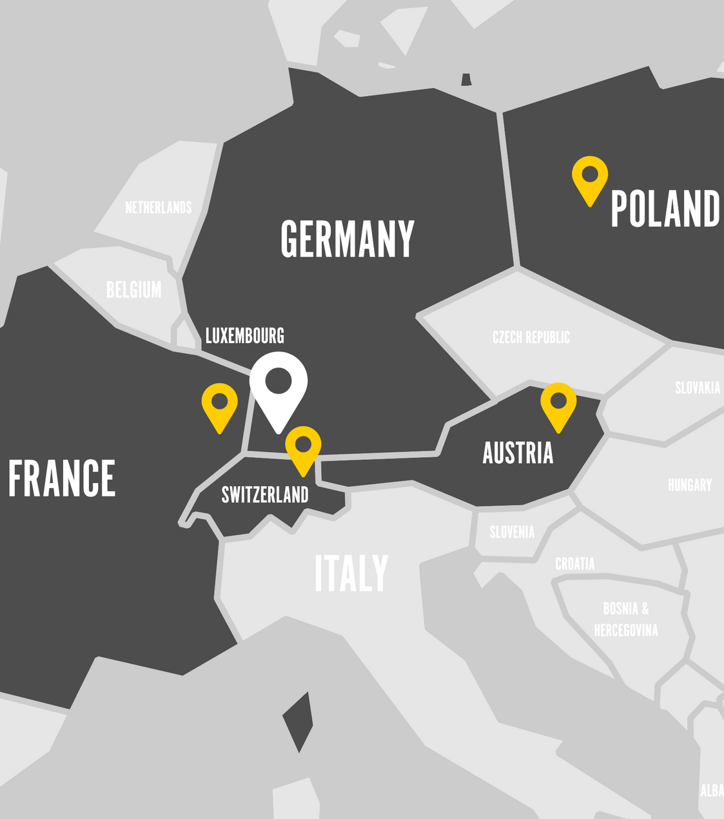
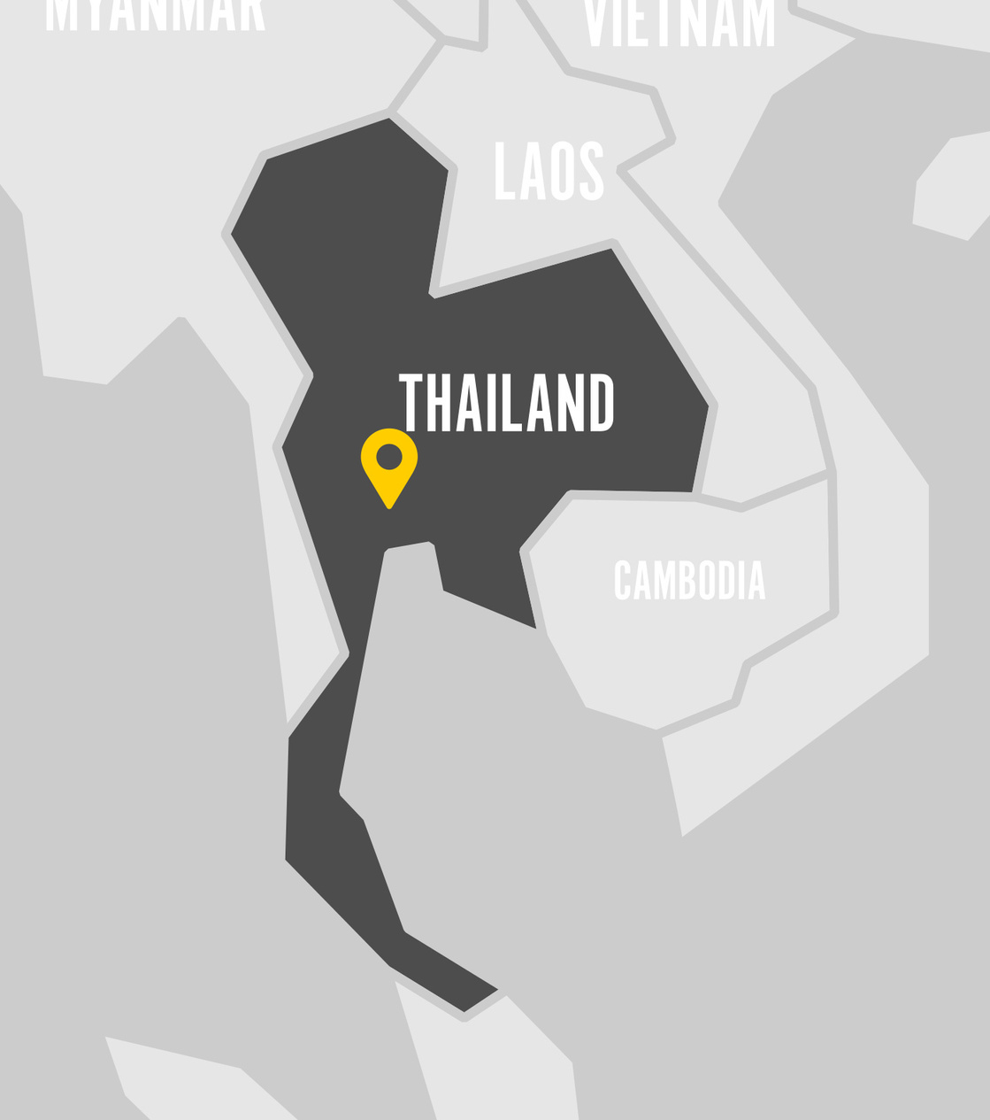
CURRENT
LOCATIONS
EUROPE
CURRENT
LOCATIONS
ASIA

Slide 6
OUR TOP PRIORITY?
CUSTOMER SATISFACTION!
With more than 75 years of expertise, our company stands as one of the world's foremost producers of confectionery decorations.
We craft exquisite decorations and premium gift packaging for all occasions. What sets us apart is our control over every aspect, from design and development to production. This uniqueness defines us.
Our commitment to customer satisfaction, understanding of their needs, and creative drive serve as the foundation for our optimal product development.
Our extensive sales network ensures that our customers receive top-notch advice and support.
Because of our exceptional flexibility, we are highly skilled at overseeing the entire process, which spans from designing and producing products to handling logistics and presenting them at the point of sale.
We cater to a diverse clientele across more than 20 countries. Our customers include specialty wholesalers, grocery retailers, discount stores, confectionery shops, large hypermarkets, and food manufacturers/processors.

Slide 7
HIGHEST REQUIREMENT:
TO US AND OUR PRODUCTS
Around 900 employees are diligently working across 10 different countries, adhering to the rigorous quality standards set by the IFS (International Featured Standards).
Our factory in Thailand holds BSCI certification.
We have obtained certifications for our chocolate and cocoa butter from either Rainforest Alliance or COCOA Horizons.
All of our product packaging is fully recyclable.
Our products are entirely free from azo dyes.
If the renunciation of palm oil is unavoidable, we exclusively utilize RSPO-certified palm oil.

Slide 8
WHAT WE VALUE THE MOST
IS THE BEST QUALITY
In order to optimally meet customer needs, we have formulated the following goals in our corporate policy:
Meticulous selection of our manufacturers.
Providing fast and dependable service to our customers.
Updating our equipment to meet current standards.
Ensuring that all our employees adhere to stringent hygiene regulations.
Continuously training our employees to maintain high standards.
We employ premium ingredients and maintain a constant vigilance over product quality and adherence to regulatory standards.
We actively engage in the advancement of new production systems and the refinement of our manufacturing processes.
We place significant emphasis on upholding elevated ethical, social, and ecological standards. These standards extend not only to our company but also to our closely collaborative suppliers.

Slide 9
THE THREE MAIN CATEGORIES
OUR SWEET PRODUCTS
This product line is distinguished by its imaginative decoration and user-friendly design, specifically developed for the end consumer.
Discover a wide range of high-quality decorations and accessories for pastry, confectionery and gastronomy, and let your creativity soar.
Explore our exclusive and diverse selection of high-quality gifts designed for every special occasion.

Slide 11
Our product range is versatile, encompassing a variety of items, including:

Slide 12
Our product range is versatile, encompassing a variety of items, including:
An assortment of chocolate and sugar sprinkles.

Slide 13
Our product range is versatile, encompassing a variety of items, including:
An assortment of chocolate and sugar decorations.

Slide 14
Our product range is versatile, encompassing a variety of items, including:
a selection of the finest wafer products

Slide 15
Our product range is versatile, encompassing a variety of items, including:
rolled fondant in a wide array of colors

Slide 16
Our product range is versatile, encompassing a variety of items, including:
a variety of food colors and flavors for your culinary needs.

Slide 17
Our product range is versatile, encompassing a variety of items, including:
writing icing, royal icing, and glazes

Slide 18
Our product range is versatile, encompassing a variety of items, including:
baking supplies and candles

Slide 19
Our product range is versatile, encompassing a variety of items, including:
glimmer and gold products

Slide 20
INNOVATIONS
BAKING DECOR
Our ability to include elements of various sizes into sprinkle mixes decors provides you with the utmost flexibility in this product category. Explore our custom-made premium sprinkles and experience it for yourself!

Slide 21
INNOVATIONS
BAKING DECOR
Our ability to include elements of various sizes into sprinkle mixes decors provides you with the utmost flexibility in this product category. Explore our custom-made premium sprinkles and experience it for yourself!

Slide 22
THE THREE MAIN CATEGORIES
OUR SWEET PRODUCTS
This product line is distinguished by its imaginative decoration and user-friendly design, specifically developed for the end consumer.
Discover a wide range of high-quality decorations and accessories for pastry, confectionery and gastronomy, and let your creativity soar.
Explore our exclusive and diverse selection of high-quality gifts designed for every special occasion.

Slide 24
DECOR-PARTNER
FOR PASTRY & CONFECTIONERY
Our product range is diverse and includes, among other things:
Various stylish decorations and accessories.
Customized products to meet specific requirements.
Trendy items suitable for every season of the year.
A wide array of products designed for those special occasions in life.

Slide 25
Our product range is versatile, encompassing a variety of items, including:

Slide 26
Our product range is versatile, encompassing a variety of items, including:
a variety of chocolate and sugar sprinkles

Slide 27
Our product range is versatile, encompassing a variety of items, including:
figures made of sugar and marzipan

Slide 28
Our product range is versatile, encompassing a variety of items, including:
decorative cake toppers crafted from both icing and chocolate

Slide 29
Our product range is versatile, encompassing a variety of items, including:
chocolate transfer foils and specialty decorations

Slide 30
Our product range is versatile, encompassing a variety of items, including:
We also offer decorations made from non-edible materials for various decorative purposes.

Slide 31
Our product range is versatile, encompassing a variety of items, including:
variety of chocolate decorations

Slide 32
Our product range is versatile, encompassing a variety of items, including:
a range of accessories for confectionery, like cake laces and bridal couples

Slide 33
Our product range is versatile, encompassing a variety of items, including:
a selection of products designed to visually enhance surfaces, such as sprays containing cocoa butter or mica powder

Slide 34
THE THREE MAIN CATEGORIES
OUR SWEET PRODUCTS
This product line is distinguished by its imaginative decoration and user-friendly design, specifically developed for the end consumer.
Discover a wide range of high-quality decorations and accessories for pastry, confectionery and gastronomy, and let your creativity soar.
Explore our exclusive and diverse selection of high-quality gifts designed for every special occasion.

Slide 36
THE SWEET WORLD
OF GIFTS
"Chocolate Emotion - Emotions Crafted in Chocolate. Our name tells the whole story. WE EVOKE EMOTIONS - because we feel them!"
Our gifts stand out from the rest; they are emotionally touching, feature exquisitely finished surfaces, and may even include gold or silver embossing.
We offer CE-certified stuffed animals, delightful polyresin figures, and premium accessories that are exclusive to our collection.
Each piece undergoes a thorough development process, involving careful selection, meticulous design, and a keen focus on intricate details.
To complete the experience, our exquisite pralines are crafted in-house using couvertures and fillings sourced from BARRY CALLEBAUT (SWITZERLAND). They add a touch of excellence and a velvety texture to every small gift.

Slide 37
Our product range is versatile, encompassing a variety of items, including:

Slide 38
Our product range is versatile, encompassing a variety of items, including:
Delight in sweet praline hearts suitable for any occasion.

Slide 39
Our product range is versatile, encompassing a variety of items, including:
Discover our gift boxes filled with a delectable assortment of chocolates.

Slide 40
Our product range is versatile, encompassing a variety of items, including:
Explore our selection of marzipan gifts, perfect for those who appreciate this sweet and almond-based delicacy.

Slide 41
Our product range is versatile, encompassing a variety of items, including:
Indulge in our chocolate gifts accompanied by a range of delightful accessories.

Slide 42
Our product range is versatile, encompassing a variety of items, including:
Enjoy our chocolate gifts that come with adorable stuffed animals.

Slide 43
Our product range is versatile, encompassing a variety of items, including:
Savor our chocolate gifts adorned with decorations crafted from wood, ceramics, textiles, and various other materials.

Slide 44
Our product range is versatile, encompassing a variety of items, including:
Delight in our chocolate gifts adorned with charming felt decorations.

Slide 45
With these diverse options, we create product collections that present a perfect visual appeal on the shelf.

Slide 46
A SWEET CANVAS
FOR YOUR IDEAS
Personalize your creations with your very own logo.
Do you own a confectionery or bakery? We can incorporate your logo onto chocolate, icing, sugar paste, or marzipan for your products.
Do you have your own brand? We also offer private label manufacturing. We can bring your ideas to life, whether it's marzipan, sugar, chocolate, or more.
Are you in search of customer gifts, or do you have a unique idea for your own custom gift item? We can also create praline hearts, thalers, and other larger gift packaging tailored specifically to your needs.

Slide 47
Address
GÜNTHART & Co. KG
main street 37
D-79801 Hohentengen a. H.
Germany
www.backdecor.com
phone number
+49 7742 859-0
www.guenthart.com
E-mail
export@guenthart.com
Website
www.guenthart.com/kontakt
www.chocolate-emotion.com

